Slide 1
The Genius Behind the Theory of Relativity
By Christopher M. Genco Jr.

Slide 2
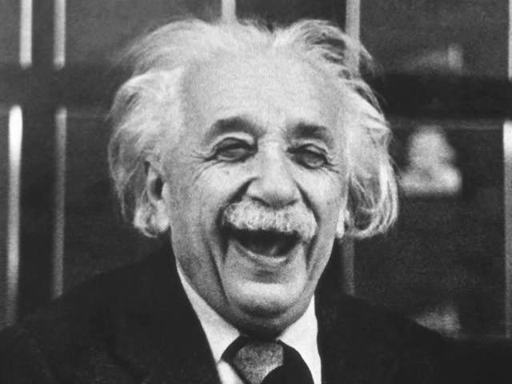
What do you know about this guy?

Slide 3
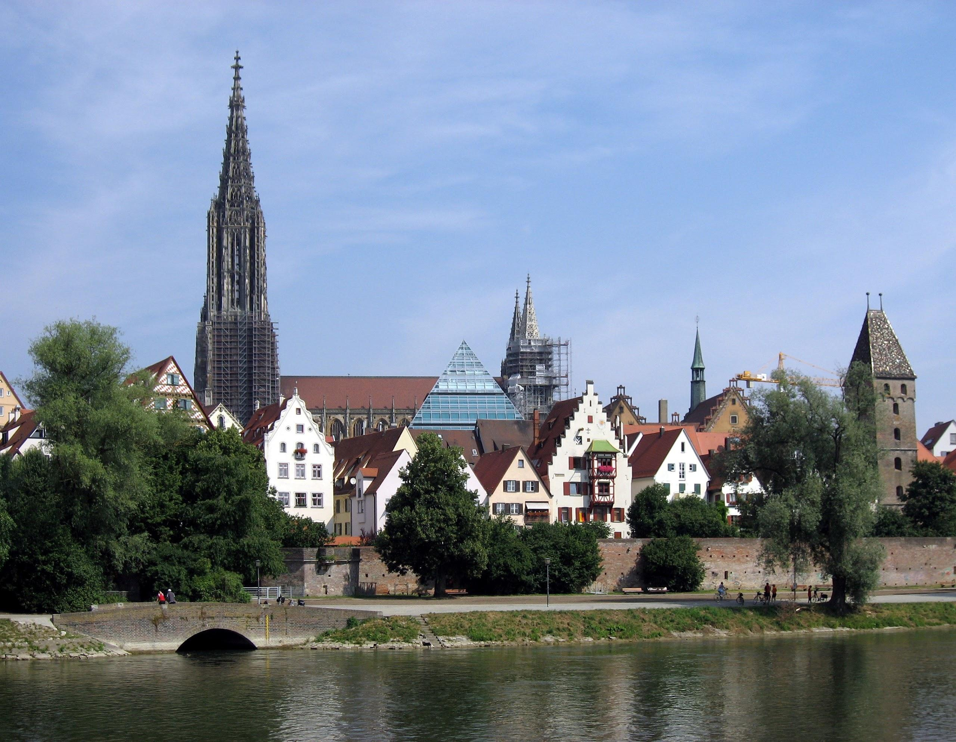
Born: March 14, 1879
Ulm, Wurttemberg, Germany
Father: Hermann Mother: Pauline
Sibling: Maja

Slide 4
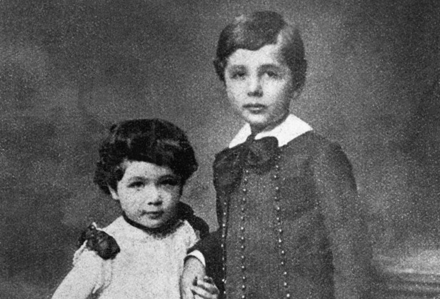
Early Life
Luitpold Gymnasium, Munich
Prussian Education System
Max Talmud - 1889

Slide 5
Transition Period
Father’s Company Fails
Drops out of Luitpold
Moves to Milan
No Degree

Slide 6
Teen and College Years
Needs Schooling
Entrance exam botched except for math and physics.
Swiss Federal Polytechnic School accepts him Contingent on completion of formal high school.

Slide 7
Life is Good
Thrived in Switzerland
Renounced his German Citizenship
Friends: Marcel Grossmann, Michele Besso
Academic Rebel

Slide 8
Turn for the worse
Becomes Notorious in Academia
In love with Maleva Maric
Has illegitimate daughter in 1902
Father Loses Job Again
Grossmann to the Rescue

Slide 9
1905
Patent clerk
Reviewed electromagnetic devices
Maxwell theories violate Newton’s Laws

Slide 10
Problem: Maxwell =/= Newton
Maxwell: Unifies Optics + Electromagnetism
Newton: Reference Matters

Slide 11
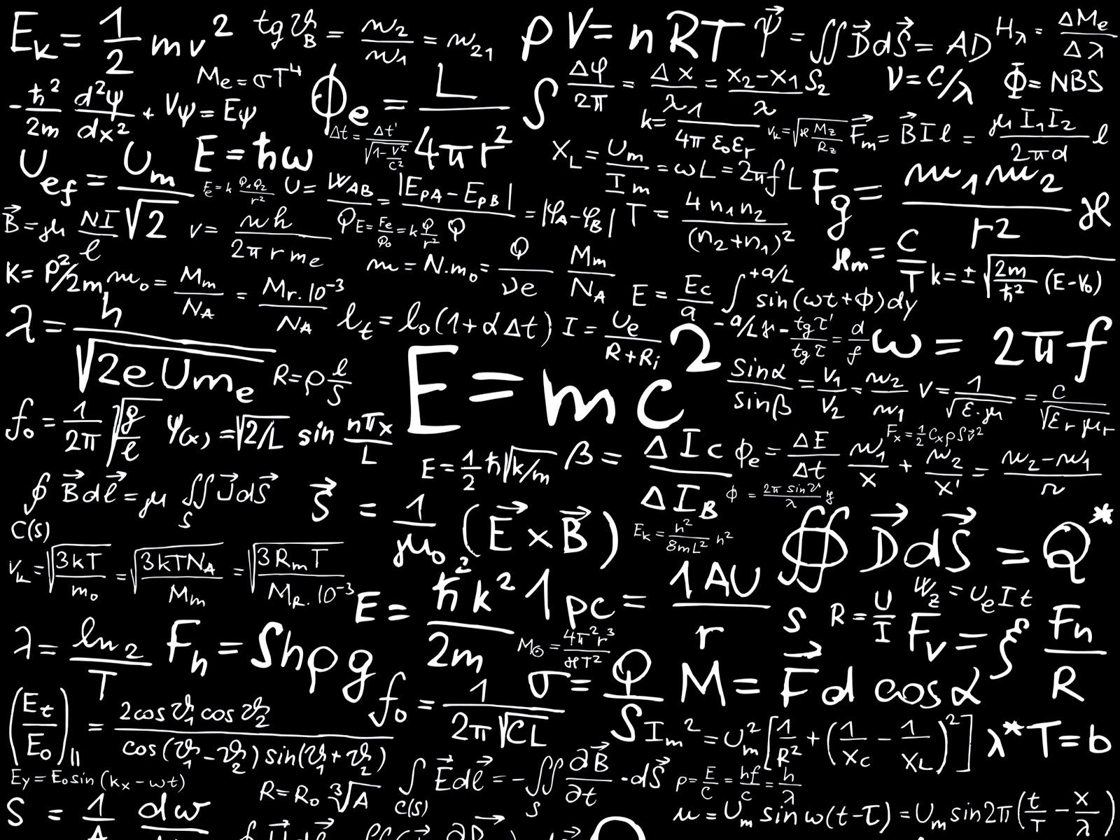
Four Paper Topics
Photoelectric Effect
Brownian Motion
Special Relativity
Equivalence of Matter + Energy

Slide 12
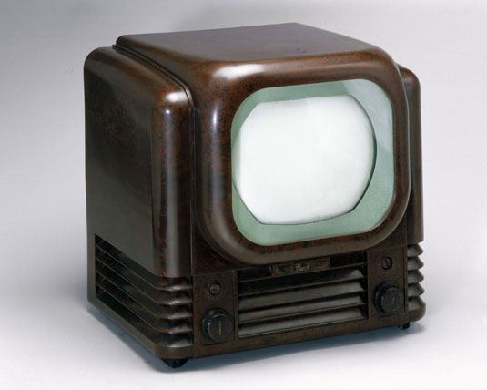
Results of these Papers
Television
The Atomic Bomb
Physical Chemistry

Slide 13
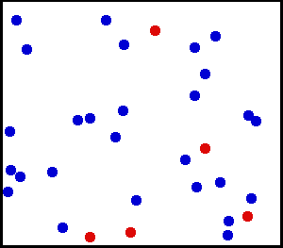
Physical Chemistry
Diffusion

Slide 14
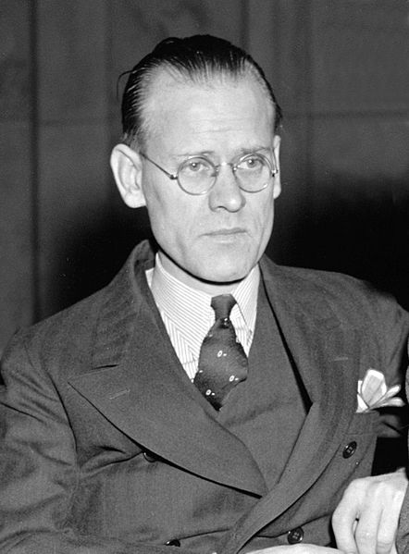
Television
Philo Farnsworth

Slide 15
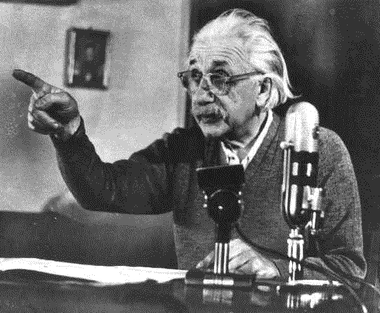
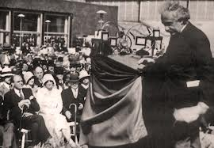
Atomic Bomb: Conception
Avid Pacifist
Nazi Germany, ends Einstein’s pacifism

Slide 16
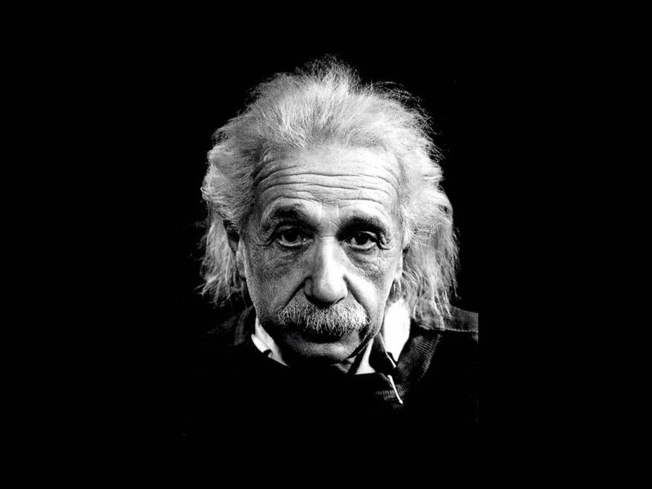
Atomic Bomb: Completion + Effects
Reason for Change
Tragic loss of life

Slide 17
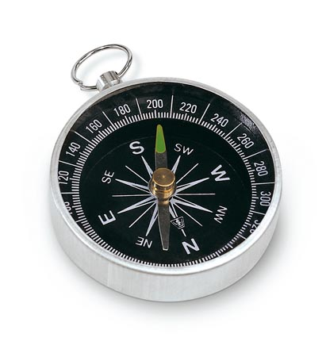
How?
Compass and Geometry
Appreciation of History

Slide 18
Einstein’s Opinion on Theories
“He believed that general theories could not be arrived at by a direct examination of the empirical facts alone”

Slide 19
Eureka

Slide 20
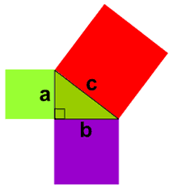
Math Math Math Math Math…
Pythagorian Theorem
Lorentz Transforms
Muons

